Slide 1
Exercise
Sort the following numbers using the radix sort.
  64, 8, 216, 512, 27, 729, 0, 1, 343, 125
Do not see the answer immediately on the next page.
  Hint: You need leading 0s for some numbers.
  Example: 64 → 064
  8 → 008
1

Slide 2
Solution (1 of 3)
Input numbers with leading 0s
  064, 008, 216, 512, 027, 729, 000, 001, 343, 125
0
1
2
3
4
5
6
7
8
9
000 | 001 | 512 | 343 | 064 | 125 | 216 | 027 | 008 | 729
Numbers after sorting on LSD
  000, 001, 512, 343, 064, 125, 216, 027, 008, 729

Slide 3
Solution (2 of 3)
Input:
  000, 001, 512, 343, 064, 125, 216, 027, 008, 729
0
1
2
3
4
5
6
7
8
9
000 001 008 | 512 216 | 125 027 729 |  | 343 |  | 064
Numbers after sorting
  000, 001, 008, 512, 216, 125, 027, 729, 343, 064

Slide 4
Solution (3 of 3)
Input
  000, 001, 008, 512, 216, 125, 027, 729, 343, 064
0
1
2
3
4
5
6
7
8
9
000 001 008 027 064 | 125 | 216 | 343 |  | 512 |  | 729
Final sorted result without leading 0s
  0, 1, 8, 27, 64, 125, 216, 343, 512, 729

Slide 5
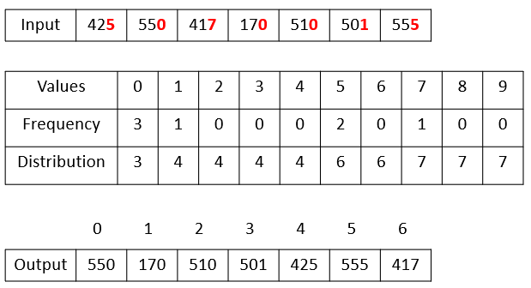
Radix Sort Implementation (1 of 3)
To sort each digit, you can use the counting sort.
Example
  This is the counting sort result for LSD.
  Note that the index of output array starts from 0.

Slide 6
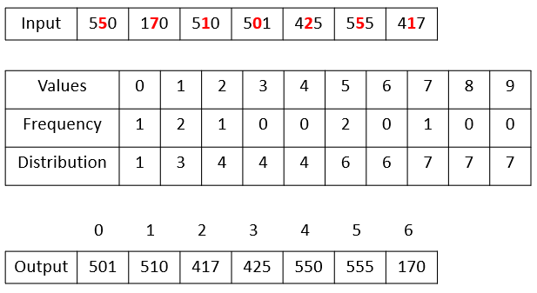
Radix Sort Implementation (2 of 3)
This is the counting sort result for the next LSD from the previous slide.

Slide 7
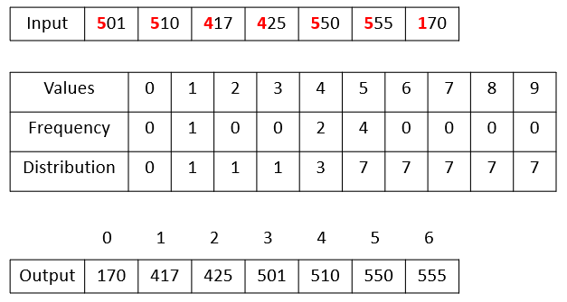
Radix Sort Implementation (3 of 3)
This is the counting sort result for the first digit (= MSD).

